Slide 1
Defining Politics Understanding State
Introduction to Human Sciences
Politics Module: Lecture 1
Radhika Krishnan and Aniket Alam
2019

Slide 2
A Quick Recap
Philosophy
Rationalism ←→ Empericism
History
Deductive ← → Inductive
Sociology
Structure ← → Agency
Politics
State ← → Citizen

Slide 3
What is Politics?
Organisation of Public Life
Art of Government
Methods for finding consensus; or compromise
Exercise of power ~~ ~~
Normative Questions
Emperical Studies
Institutionalism

Slide 4
What is Politics?
“Man is by nature a political animal”: Aristotle
Politics, the word, comes from Greek Politikos
Relating to the citizen;
Affairs of the Polis [city-state]
Expected from every [free] man
Inescapable for every [free] man

Slide 5
Subject : Citizen
Subject
Under someone’s sovereign power
Is ruled by Sovereign, his Law
Citizen
Individual [unit] who possesses sovereignty
Autonomous, Equal

Slide 6
Sovereign Citizen
Autonomy
Equality
Rights
Make it a momentum concept: internal logic pushes towards greater universality and egalitarianism
Distinction between Nationality and Citizenship
Contest between Rights and Duties
“Full and equal member of a political community”
~ T. H. Marshall ~

Slide 7
Sovereign State
Institution above individual and society
Legislates
Executes
Adjudicates
Division of power between these three
Monopoly of legitimate violence over its territory
~ Max Weber ~

Slide 8
Social Contract - I
State of Nature (total freedom)
Actions and relations based on power, self-interest
Natural laws and natural rights
Difficult life; "solitary, poor, nasty, brutish and short” (Thomas Hobbes)
Civilisation and Progress not possible
Social Contract as theory of political legitimacy
Individuals give up some freedom to a sovereign authority over them
Rational course of action; brings order; termed State
This also helps individuals organise into a civil society or political community under the care of the State

Slide 9
Social Contract - II
Most influential theory of State origin and legitimacy
Thomas Hobbes
Conservative, authoritarian perspective
Protect society from state of nature
John Locke
Liberal, limits to state power, rule of law
Based on rationality: equality and liberty
STATE HAS A MORAL MANDATE:
PROVIDING CONDITIONS FOR HUMAN PROGRESS

Slide 10
Limited Power
State under Social Contract has its power limited by law
Opposite of Absolutism
Checks and Balances : Neutral
Legitimacy based on Democracy (Popular Mandate)
State monopoly of legitimate violence provides the freedom necessary for individuals to achieve their potential

Slide 11
Unlimited Power
Marxist, Anarchist, Autonomous, Fascist theories of State power
Marxist : State instrument of Ruling Class
Anarchist : State oppressive irrespective of who rules with what form
Autonomous : State is network of institutions which are autonomous of all other influences
Fascist : State is the instrument for reshaping perfect society

Slide 12
Marxist Theory
State emerges in history to protect social surplus in private hands
State and its apparatus – legislature, executive, judiciary – is used to protect private property
State instrument of those who control social surplus to dominate / control the producers of surplus
“...modern state is nothing but a committee for managing the common affairs of the whole bourgeoisie.”
~ Karl Marx ~

Slide 13
Various Forms of State
Monarchy ⬄ Republic
Theocratic ⬄ Secular
Totalitarian ⬄ Democratic
Authoritarian ⬄ Liberal
~~ ~~ ~~
Unitary ⬄ Federation
Welfare State ⬄ Libertarian State
Nation State ⬄ Multi-national State
India
Where does it stand here

Slide 14
Indian Constitution
Introduction to Human Sciences
Politics Module: Lecture 2
Radhika Krishnan and Aniket Alam
2019

Slide 15
Main Features
Preamble
25 Parts; 12 Schedules; 5 Appendices
448 Articles
103 Amendments
Federation but Unitary
Single Citizenship
Parliamentary Democracy
Makes it the largest, most detailed, written constitution of the world
Draws on Constitutional experience from many other countries
Based on existing Government of India Act of British times
Enacted after three years of intense debate

Slide 16
Preamble
WE, THE PEOPLE OF INDIA, having solemnly resolved to constitute India into a SOVEREIGN SOCIALIST SECULAR DEMOCRATIC REPUBLIC and to secure to all its citizens
JUSTICE, social, economic and political;
LIBERTY of thought, expression, belief, faith and worship;
EQUALITY of status and of opportunity; and to promote among them all
FRATERNITY assuring the dignity of the individual and the unity and integrity of the Nation;
IN OUR CONSTITUENT ASSEMBLY this 26th day of November, 1949, do HEREBY ADOPT, ENACT AND GIVE TO OURSELVES THIS CONSTITUTION.

Slide 17
Part One
THE UNION AND ITS TERRITORY
Names and territory of Union; States
Admission or Establishment of new States
Alteration of areas, boundaries, names of States

Slide 18
Part Two
CITIZENSHIP
Who will be called a Citizen
Test of Citizenship
Dealing with Partition of 1947 into India and Pakistan and citizenship of migrants
Acquiring Citizenship
Losing Citizenship

Slide 19
Part Three
FUNDAMENTAL RIGHTS
Equality
Freedom
Right against Exploitation
Freedom of Religion
Cultural and Educational Rights
Right to Constitutional Remedies ~~ ~~ ~~
Property
Privacy

Slide 20
Part Four
Directive Principles
Non-Justiciable
Guidelines for State Policy and Adjudication
Lower to Fundamental Rights in importance
Welfare State (Income, Social equality)
Panchayats, local self-government
Right to education, work, public assistance
Humane working conditions
Uniform Civil Code
Protect forests and wildlife; historical heritage
Uplift SC, ST, weaker sections
Improve public health; child care
Cow Protection
Part Four A: Fundamental Duties

Slide 21
Other Parts and Schedules
PARTS dealing with functioning of Union Govt, States, UTs, Panchayats, Municipalities, Cooperative Societies, Scheduled and Tribal Areas, Relations between Union and States, Conduct of trade and commerce, Services, Elections, Languages, Emergency Provisions, etc
SCHEDULES encode ways in which constitutional provisions will work; bureaucratic procedures; rules
Union List
State List
Concurrent List

Slide 22
How the Constitution Came into Being
Regulating Act, 1773
Established Gov-Gen; Supreme Court; Civil Service
Charter Act, 1833
Centralised power in India
Gov-Gen’s Council (1853: provincial representation)
Government of India Act, 1858
Ruled by British Crown; Viceroy
Viceory’s Executive (Cabinet); Portfolio System
Council of India, 16 members (at least 3 Indian)
Legislative councils in Centre, Provinces

Slide 23
How the Constitution Came into Being
Government of India Act, 1909
Indian in Viceroy’s Executive
Elections to Legislative Councils; 60 seats
Separate Electorates; Communal Representation
Government of India Act, 1919
Central and Provincial subjects demarcated
Bi-cameral Legislature: Assembly 140 members; Council 60 members
3 out of 6 Viceroy’s Executive to be Indian
Government of India Act, 1935
India to be a Federation of Provinces and Princely States
Union, State, Concurrent Lists of powers
Established Constitutional Court
India Independence Act, 1947
Sovereignty vested in Indian People
Divided India into two Independent States; and gave freedom to Princely states
Established Contituent Assembly

Slide 24
Salient Features
Stress Equality and Fraternity over Liberty
Result of Constitutional and Political Debates over a century and more
Different Ideals
Social Democratic
Liberal Democratic
Gandhian Anarchist
Religious Nationalist
Social Conservative
Compromise and Consensus
Individual Rights v/s Group Rights
Secularism: State aloof of religion or State reforms religion

Slide 25
Why do we Need Constitutions
Check power of States
Check power of social majorities
Check power of socially dominant groups
Template for consensus and compromise
Give society a long term vision and strategy

Slide 26
Achievements
Universal Franchise
Civil Liberties
Religious Freedom
Affirmative Action
Asymmetric Federalism
Embody the principles of Civic Nationalism

Slide 27
Criticism
Unwieldy
Too many contrasting (contradictory) influences and inspirations
Too large and complex
Unrepresentative
Of people
Of Indian traditions
Alien Concept
Western Import
Not rooted in Indian thought

Slide 28
International Relations
Introduction to Human Sciences
Politics Module: Lecture 3
Radhika Krishnan and Aniket Alam
2019

Slide 29
What does IR deal with?
Attempts to understand and explain interactions between countries
Deals with:
POLITICAL issues: Foreign relations, War, Aid, Alliances, Terrorism, Drugs Trade
ECONOMIC issues: International trade, Sanctions, Regulations
SOCIAL/CULTURAL issues: Human rights, Migration, Ethnic and Religious Conflicts/Genocide
ACTORS: Legitimate, Non-Legitimate, State, Non-State

Slide 30
Global Political Actors
Global actors
Non-Legitimate actors
Guerilla and liberation movements
Legitimate actors
Transnational companies
Government Departments
Criminals
Political parties
NGOs

Slide 31
Levels of Analysis
Multiple levels of analysis
Individual level: Psychological and social-psychological. Attempt to explain why certain actors act the way they do
Domestic level: Institutional processes and politics within countries
International level: Character and relationship between and among participants in the international system

Slide 32
Approaches/Models
Liberal: How to reduce conflict
Realist: Why conflict endures
Radical: How to transform the entire system of state relations
Constructivist: How ideas transform systems

Slide 33
Liberalism
Makes normative claims:
Governments should pursue/defend ‘ethical’ principals (peace, justice, human rights)
Human nature is capable of reason and peaceful, harmonious interaction
Stress on Interdependence /Interconnectedness. EXAMPLES: ISIS/Syria refugee crisis, Fall of Lehman Brothers
Mutual beneficial to pursue value claims (Sharing, aiding, defending justice and rights, avoiding war).
Human security is central to Government security.

Slide 34
Liberalism - II
Liberal Institutionalists
Economic Cooperation (EU etc.)
International Organizations (UN etc.)
Iroquois League is the earliest example (1400s-1700s)
Member states retained own customs and traditions
Pledged to defend other member states
Membership was renewable
Participation in the decision making process

Slide 35
Realism
Assumptions
Human Nature is Prone to Violence and Destruction
Political Behavior is Conflict oriented
Government security is primarily as military security, not quality-of-life security
Central Argument
Interests of governments are best promoted when governments gain and hold power relative to other states
Military and economic power
U.S. involvement in Third World Conflict: Hostility of governments over ethical, humanitarian, and cooperative motives.

Slide 36
Realism – II
Governments exist in relations of international anarchy; thus prone to conflict.
Anarchy: Absence of any overarching world government that enforces rules of peace on existing governments
UN is not above the influence of powerful governments and cannot independently make decisions
> States must be powerful or should align with the powerful.
Foreign policy based on strategic military objectives is thoroughly rational choice
Moral principles take a back seat – e.g. US’s position on Terrorism

Slide 37
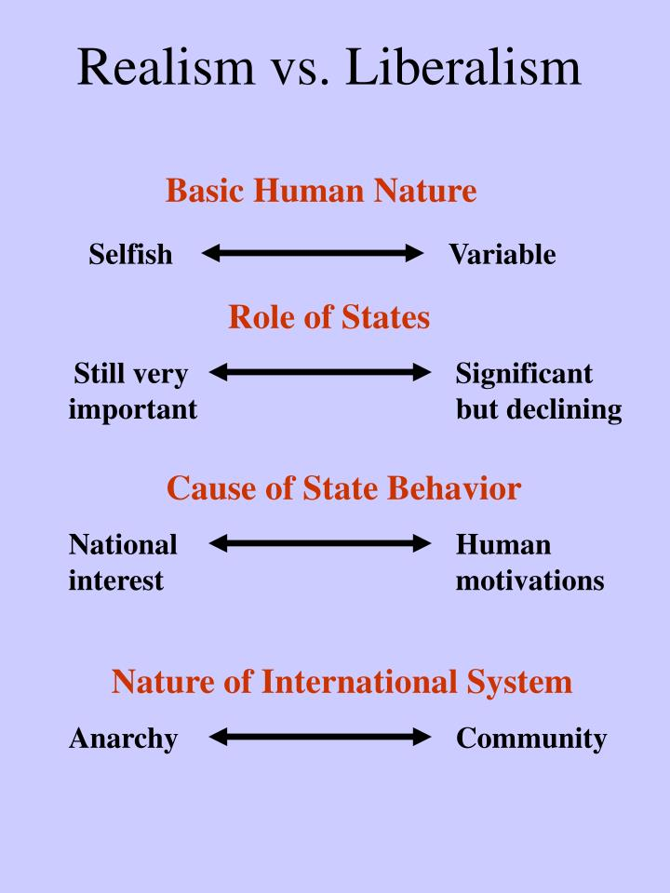

Slide 38
Radical/Constructivist Approaches
Marxism:
Capitalism and Globalization as the source of international tensions.
Neo-marxist Dependency theory
World Systems Theory
Constructivism:
IR is a product of human action, socially constructed
Highlight ideas, knowledge, norms, and rules to understand the origins of state’s interests
“Power Politics”, Anarchy is human made

Slide 39
CONCEPTS

Slide 40
Concepts: Balance of Powers
States act to preserve a balance of power in the system
No one entity should become all-powerful and gain the ability to push its will upon the others
Maintain equilibrium
Assume: when one State’s power (economic and military) increases -> Others will take measures to balance
That means increasing their own military and economic capacity
Resource and monetary constraints often prevent this
Hence alliances

Slide 41
Mechanisms for BoP
Military spending
Alliances
Military Alliances
Economic Alliances
How and Why do alignments work?
Use others to check competitors
Partition
Compensation in postwar peace
Protectionism and tariff barriers

Slide 42
More Concepts
Deterrence
Persuade opponent not to initiate action
Protects status quo
Difficult to measure if success is due to deterrence
Compellence
Persuade opponent to change behaviour
Aims to change status quo
State Building
To stabilize violent conflicts (eg. US role in Somalia, Balkans, Iraq, Afghanistan; 1992 UN Agenda for peace)
Humanitarian intervention

Slide 43
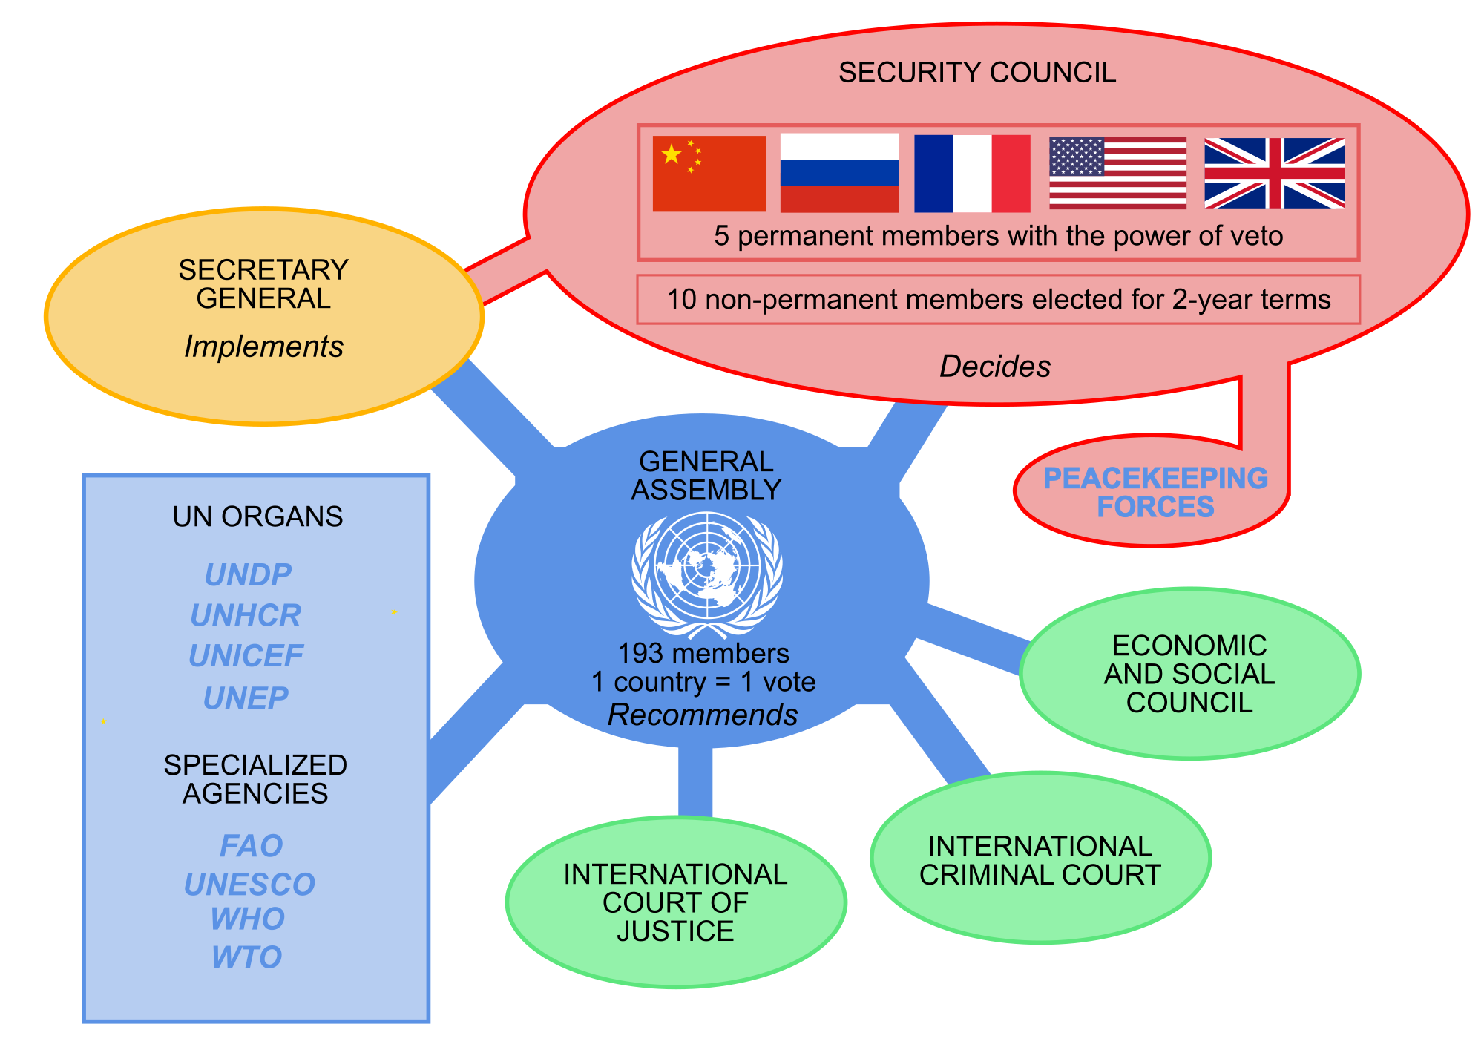
United Nations at a Glance

Slide 44
United Nations
Effectiveness
Provides a forum for debate and discussion for diverse countries
Striking a balance between Military and Human Security
Cooperation with NGOs, provides citizens and social movements an arena for participating in politics beyond the borders of their own countries
Limitations
UN, as an organization, is actually in a subordinate relationship relative to states e.g.- troops deployment
Critics contend that the UN is actually dominated by superpower states, such as the United States e.g.- US’s invasion of Iraq
The Question of State Sovereignty

Slide 45
Indian Party System
Introduction to Human Sciences
Politics Module: Lecture 4
Radhika Krishnan and Aniket Alam
2019

Slide 46
Questions
Why has India succeeded in becoming a resilient multi-party democracy and not lapsed into a non-democratic system?
How has India with deep diversity and deep seated inequalities managed to hold-together and also move towards a more egalitarian society?
How have modern institutions taken root in a country far removed from modernity? And CAN they collapse?

Slide 47
The Indian Party System
Multi-party system
1952: 55 parties.
2014: 464 parties.
Kinds of parties
Right-wing (in terms of economic/social policy). Swatantra party, BJS, BJP
Left-wing. CPI, CPI(M)
Centrist. Congress
Regional parties

Slide 48
1952 Lok Sabha Elections

Slide 49
2014 Lok Sabha Elections

Slide 50
The Indian Party System
What are parties supposed to do?
Articulate specific demands
Attempt to legitimately capture political power
“Primary instrumentality through which democracy could be operationalized in letter and spirit” (Bidyut Chakravarty and R.K. Pandey)
Phases:
1952-64 (Nehruvian era of national consensus)
1964-69 (Uneasy transition, emergence of a multi-party system)
1969-75 (New consensus and increasing inter-party conflict)
1975-77 (Emergency)
1980-89 (Tussle between the Congress at the centre and the newly emerged regional parties at the state level)
1989 to the present (The emergence of an established multi-party system and coalition politics)

Slide 51
The “Congress System”
Congress as an Umbrella, accommodating various voices.
Various ‘interests’ (religion, region, class, caste etc.) articulated by a single party.
Internal consensus within Congress (party of consensus)
Small parties ~ Pressure groups (parties of pressure)
Monopoly of Congress
Upper and Middle Class party with Mass Support.
Only feeble alternative were the Communists/Socialists.
Dominated first 3 elections, fragmented opposition.
Formation of Swatantra Party in 1959, consolidation of the Right Wing
Locality-oriented pluralist model of electoral mobilization.
Homogeneous elite in roles of authority and decision-making.

Slide 52
Congress System
Faction_1
Pressure_1
Faction_2
Pressure_2
Faction_4
Pressure_4
Faction_3
Pressure_3
Margin of Pressure
Margin of pressure
Party of Consensus

Slide 53
The Indira Era
Began with Two turning points
Indo-China War
Demise of Nehru
Economic Crisis, Fading of Nehruvian dream, Corruption, Opposition unity
Populist Politics of Indira Gandhi
Garibi Hatao
India-Pakistan war of 1971
Green Revolution
Ended with De-institutionalization of the Congress party. Outside support from Communists – Coalition sustained by hitherto sworn enemies, but preeminence of Congress party.

Slide 54
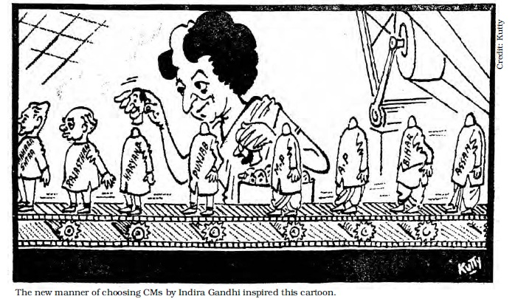

Slide 55
The Indira Era - II
Charismatic Indira, “Indira is India”. Nationally-oriented personalized mass appeal model of political mobilization.
Rising Protests in States – Strikes and Processions in Bihar (1974)
The JP Movement
Against the rising corruption under Congress
Demanding resignation of Government
Court in Allahabad ruled that Mrs. Gandhi was guilty of electoral malpractice
Declaration of Emergency
Opposition leaders were jailed, and the press censored

Slide 56
The Indira Era – III and the Coalition Era
Impact of Emergency, exposing destruction of Institutions.
1977 elections
Formation of Janta Party (Congress (O),Jana Sangh, Bhartiya Lok Dal, and the Socialist Party)
Congress witnessing an astounding loss
Shift from a One person dominant leadership to collective leadership
Constitutional reform under Morarji Desai
Internal contradictions within Janta party leading to its collapse in 1979.
Post-1989 – Coalition as fait accompli
General Elections of 1989 (Janata Dal-led coalition), 1991 (Congress –led coalition), 1998 mid-term elections .
By 1989: Crystallization of coalition politics.

Slide 57
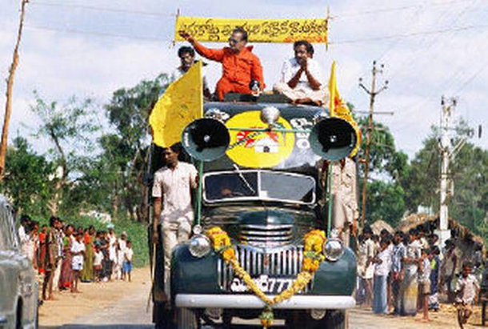
Regional Parties
Phenomenon picks up momentum after 1967. About four dozen recognized state parties and about two dozen more which are not yet recognized by the Election Commission of India
Why? National parties’ ‘neglect’ of the political and economic interests of the region or even the state.
Controlled and driven by one leader whose writ runs large in party affairs.

Slide 58
Regional Parties - II
Samajwadi Party, Rashtriya Janta Dal (Socialism, with Yadav-Muslim vote base)
Bahujan Samaj Party
Janata Dal (Secular)
DMK, AIADMK
Trinamool Congress
Biju Janata Dal
Asom Gana Parishad
Jharkhand Mukti Morcha
National Congress, PDP in J&K

Slide 59
Pressure Groups
Non-political formations, articulating interests of specific groups.
RSS, VHP, Bajrang Dal, Jamaat-e-Islami, All India Kisan Sabha, Bharatiya Kisan Union, Harijan Sevak Sangh, Nadar Caste Association etc.
Can be viewed as extra-constitutional entities which may not be afforded any space in the political system of the country.
Traditional pressure groups: Not on the basis of occupational and secular bases. Based on ascribed identities such as caste, language and religion.
New pressure groups, new bases, new issues.
Policies and their implications – SEZ in West Bengal, Utilizing the Yamuna Catchment Area for CWG

Slide 60
Major Issues in Indian Politics
Caste
Massive disparity in 1947, need for policy interventions.
Rise of aspirations of SC/ST/OBCs.
Rise of OBC Politics, Altered texture of Indian politics
OBCs provided the leadership of those parties which pushed the Congress party out of power in 1967.
Resurgence in post-Independence era because of the Mandal Commission report (1989) – deepening of democracy.
Issues of poor representation (<5% in the public sector).
Enduring Significance

Slide 61
Major Issues in Indian Politics
Religion and Politics
Hindutva ideology: Creating a pan-Hindu unity (with Dalits/OBS/Adivasis) and the Muslim ‘other’.
Mandir agenda and the Rath Yatra
Ghar vapasi
Citizenship Amendment Bill
Uniform Civil Code

Slide 62
Major Issues in Indian Politics
Economic issues
Collapse of the former Soviet Union, move towards a market-oriented economic system. Weakening of economic development.
China’s success and its impact.
Continuing prevalence of welfarism (NREGA, Farm Loan waivers, Uniform basic Income)
Gender
Women’s Movement (1975 onwards)
Sati, Dowry, Anti-rape, Personal laws, Sex-determination of the fetus
Women’s reservation bill
Section 377
Transgender person’s rights (2014 supreme court judgment)

Slide 63
Conclusion
The regionalization of politics
Growth of new social constituencies
Changing terms of political discourse
Weaknesses of India’s political structures (Judiciary, CBI, Media)

